Slide 1
JavaScript , JSON,AJAX
Reference: W3Schools

Slide 2
JS Primitive
A primitive value is a value that has no properties or methods.
A primitive data type is data that has a primitive value.
Primitive Data Types
string
number
boolean
null
undefined

Slide 3
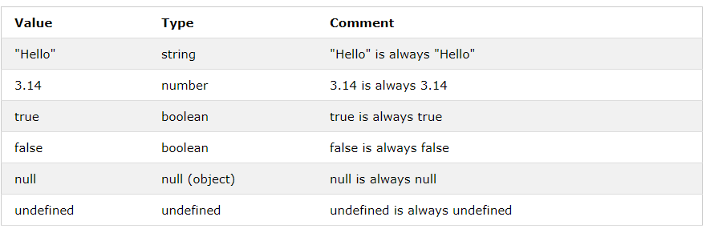
Data Types

Slide 4
In JavaScript, almost "everything" is an object.
Boolean if defined with “new” keyword are objects
Number if defined with “new” keyword are objects
String if defined with “new” keyword are objects
Date are always objects
Math are always objects
Regular Expression are always objects
Arrays are always objects
Function are always objects

Slide 5
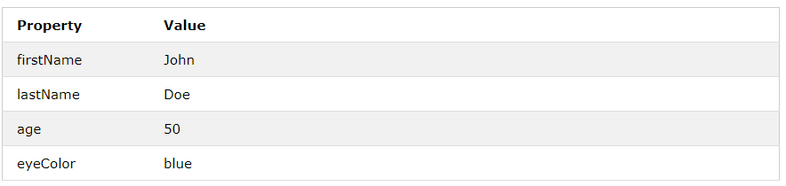
JavaScript Object
A JavaScript object is a collection of named values
var person = {firstName:"John", lastName:"Doe", age:50, eyeColor:"blue"};
The named values, in JavaScript objects, are called properties.

Slide 6
Sample Code
<!DOCTYPE html>
<html>
<body>
<p>Creating a JavaScript Object.</p>
<p id="demo"></p>
<script>
var person = {
firstName : "John",
lastName : "Doe",
age : 50,
eyeColor : "blue"
};
document.getElementById("demo").innerHTML = person.firstName + " " + person.lastName;
</script>
</body>
</html>

Slide 7
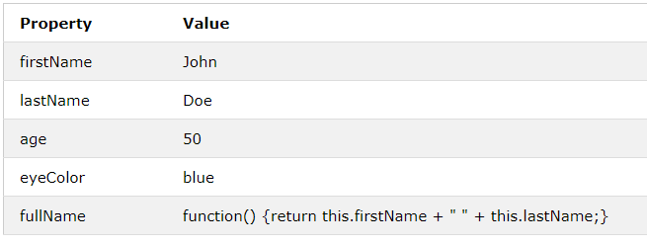
Object Methods
Methods are actions that can be performed on objects.
Object properties can be both primitive values, other objects, and functions.
An object method is an object property containing a function definition.

Slide 8
Creating JavaScript Objects
Create Object using create object literal
Create Object using new keyword
Create Constructor using constructor create object

Slide 9
Using Object literal
var person = {firstName:"John", lastName:"Doe", age:50, eyeColor:"blue"};
var p = { firstName: "John", lastName: "Doe", age: 50, eyeColor: "blue" };

Slide 10
Object using JavaScript Keyword “new”
var person = new Object(); person.firstName = "John"; person.lastName = "Doe"; person.age = 50; person.eyeColor = "blue";

Slide 11
JavaScript Objects are Mutable
Objects are mutable: They are addressed by reference, not by value.
If person is an object, the following statement will not create a copy of person
var person = {firstName:"John", lastName:"Doe", age:50, eyeColor:"blue"} var x = person; x.age = 10; // This will change both x.age and person.age

Slide 12
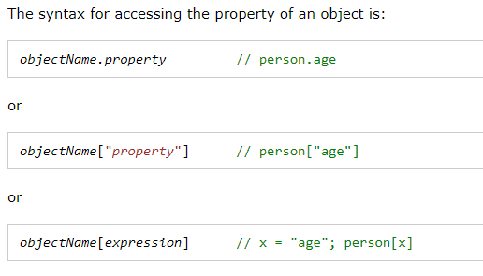
Accessing Object Properties

Slide 13
Example
var person = {fname:"John", lname:"Doe", age:25};
person.firstname + " is " + person.age + " years old.";
person["firstname"] + " is " + person["age"] + " years old.” for (x in person) { txt += person[x]; }

Slide 14
Adding New Properties
You can add new properties to an existing object by simply giving it a value.
Assume that the person object already exists - you can then give it new properties:
person.nationality = “Pakistan";

Slide 15
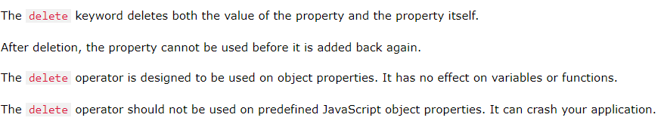
Deleting Properties
var person = {firstName:"John", lastName:"Doe", age:50, eyeColor:"blue"};
delete person.age; // or delete person["age"];

Slide 16
Calling Object Methods
objectName.methodName()
name = person.fullName();
Person.fullName

Slide 17
GetterMethod
// Create an object: var person = { firstName: "John", lastName : "Doe", language : "en", get lang() { return this.language; } }; // Display data from the object using a getter: document.getElementById("demo").innerHTML = person.lang;

Slide 18
Setter
var person = { firstName: "John", lastName : "Doe", language : "", set lang(lang) { this.language = lang; } }; // Set an object property using a setter: person.lang = "en"; // Display data from the object: document.getElementById("demo").innerHTML = person.language;

Slide 19
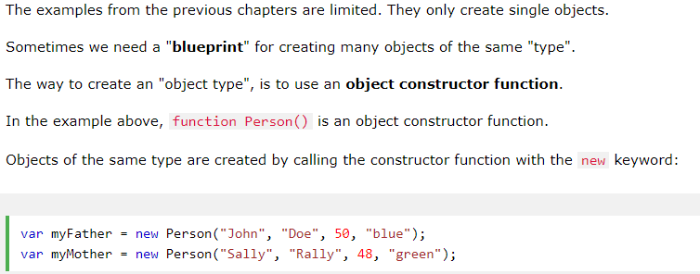
Object Types / Classes

Slide 20
Constructor
function Person(first, last, age, eye) { this.firstName = first; this.lastName = last; this.age = age; this.eyeColor = eye; }

Slide 21
New Property or Method
Adding a Property to an Object vs Constructor
Adding a Method to an Object vs Constructor
We also learned that you can not add a new property to an existing object constructor:

Slide 22
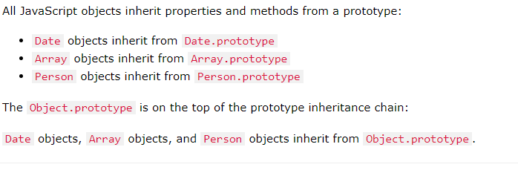
Parent class or Prototype

Slide 23
Using prototype
Prototype allows to add new properties and functions to constuctors
function Person(first, last, age, eyecolor) { this.firstName = first; this.lastName = last; this.age = age; this.eyeColor = eyecolor;
// this.nationalty=”English” } Person.prototype.nationality = "English";

Slide 24
Adding function using protoype
function Person(first, last, age, eyecolor) { this.firstName = first; this.lastName = last; this.age = age; this.eyeColor = eyecolor; } Person.prototype.name = function() { return this.firstName + " " + this.lastName; };

Slide 25
Property Attributes
Writable: If false, the value of the property can not be changed.
Configurable: If false, any attempts to delete the property or change its attributes (Writable, Configurable, or Enumerable) will fail.
Enumerable: If true, the property will be iterated over when a user does for (var prop in obj){} (or similar).
Value.
Object.defineProperty(person, "language", {writable:true,enumerable:false});
person.language=”English”

Slide 26
Write Constructor function for Car
Model
Year
Milage
engineNum
Color
Brand
getAllInfo()

Slide 27
JSON
JSON: JavaScript Object Notation.
JSON is a syntax for storing and exchanging data.
JSON is text, written with JavaScript object notation.

Slide 28
JSON Syntax Rules
JSON syntax is derived from JavaScript object notation syntax:
Data is in name/value pairs
Data is separated by commas
Curly braces hold objects
Square brackets hold arrays

Slide 29
JSON - Evaluates to JavaScript Objects
The JSON format is almost identical to JavaScript objects.
In JSON, keys must be strings, written with double quotes:
JSON
{ "name":"John" }
Javacript
{ name:"John" }

Slide 30
JSON Values
In JSON, values must be one of the following data types:
a string
a number
an object (JSON object)
an array
a boolean
null

Slide 31
JSON Files
The file type for JSON files is ".json"
The MIME type for JSON text is "application/json"

Slide 32
JSON Example
var jsonstring=’{"employees":[ { "firstName":"John", "lastName":"Doe" }, { "firstName":"Anna", "lastName":"Smith" }, { "firstName":"Peter", "lastName":"Jones" } ]}’
employeesobj=JSON.parse(jsonstring)
arr=employeesobj.employees
for obj in arr:
console.log(obj.firstName)
var car={model:”audi” , year:2020}
jsonstring=JSON.stringify(car)

Slide 33
XML Example
<employees> <employee> <firstName>John</firstName> <lastName>Doe</lastName> </employee> <employee> <firstName>Anna</firstName> <lastName>Smith</lastName> </employee> <employee> <firstName>Peter</firstName> <lastName>Jones</lastName> </employee> </employees>

Slide 34
JSON VS XML
Both JSON and XML are "self describing" (human readable)
Both JSON and XML are hierarchical (values within values)
Both JSON and XML can be parsed and used by lots of programming languages
Both JSON and XML can be fetched with an XMLHttpRequest

Slide 35
JSON vs XML
JSON doesn't use end tag
JSON is shorter
JSON is quicker to read and write
JSON can use arrays
The biggest difference is:
XML has to be parsed with an XML parser. JSON can be parsed by a standard JavaScript function.

Slide 36
Why JSON
For AJAX applications, JSON is faster and easier than XML:
Using XML
Fetch an XML document
Use the XML DOM to loop through the document
Extract values and store in variables
Using JSON
Fetch a JSON string
JSON.Parse the JSON string

Slide 37
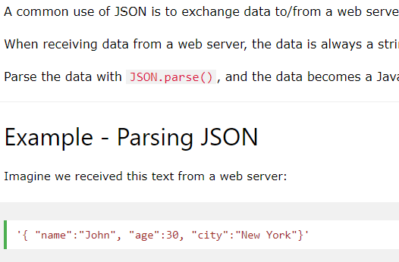
JSON.parse()
var obj = JSON.parse('{ "name":"John", "age":30, "city":"New York"}');

Slide 38
Stringify a JavaScript Object
var obj = { name: "John", age: 30, city: "New York" };
var myJSON = JSON.stringify(obj);

Slide 39
AJAX
AJAX is a developer's dream, because you can:
Read data from a web server - after the page has loaded
Update a web page without reloading the page
Send data to a web server - in the background

Slide 40
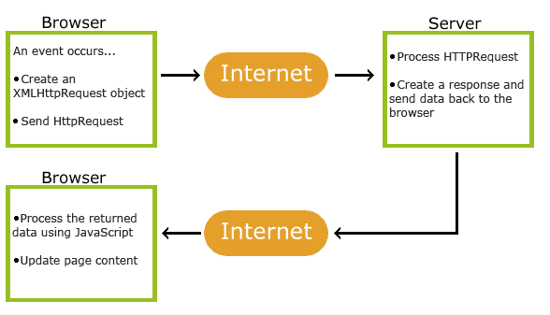
How AJAX Works

Slide 41
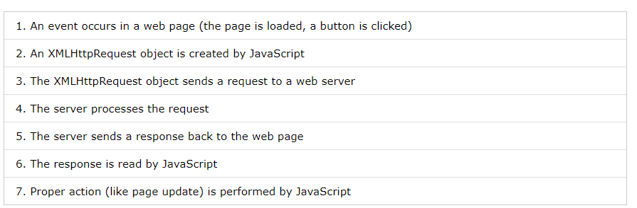
How AJAX Works

Slide 42
Create an XMLHttpRequest Object
var xhttp = new XMLHttpRequest();
For security reasons, modern browsers do not allow access across domains.
This means that both the web page and the XML file it tries to load, must be located on the same server.
The examples on W3Schools all open XML files located on the W3Schools domain.
If you want to use the example above on one of your own web pages, the XML files you load must be located on your own server.

Slide 43
Older browser version
if (window.XMLHttpRequest) { // code for modern browsers xmlhttp = new XMLHttpRequest(); } else { // code for old IE browsers xmlhttp = new ActiveXObject("Microsoft.XMLHTTP"); }

Slide 44
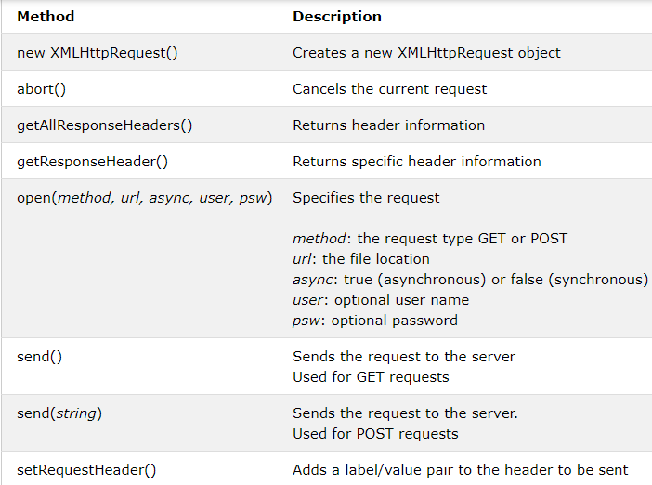
xmlHttpRequest Methods

Slide 45
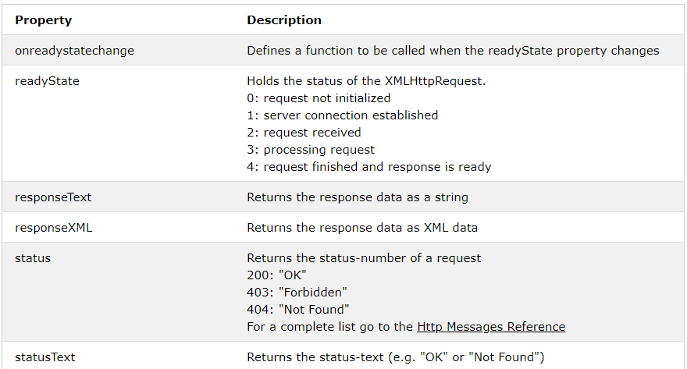
XMLHttpRequest Object Properties

